Slide 1
Building LOA5 Animated Humanoids using HAnim and X3D
Creating the Bones examples in HAnim Archive
Don Brutzman and Joe Williams
Humanoid Animation (HAnim) Working Group
Web3D Consortium
draft 27 APR 2026

Slide 2
Humanoid Animation (HAnim) Overview
HAnim is an abstract representation for modelling 3D articulated figures, including but not limited to human beings.
The HAnim specification is an International Standard that describes a standard way of representing humanoids. When followed, HAnim allows human figures created with modelling tools from one developer to be animated using tools from another developer.
HAnim is directly implemented in the X3D Architecture with examples that are widely available and deployable.
HAnim Architecture draft v4.1 is tracking current developments

Slide 3
X3D Overview
Extensible 3D (X3D) is a software standard for defining interactive web- and broadcast-based 3D content integrated with multimedia.
X3D is intended for use on a variety of hardware devices and in a broad range of application areas such as engineering and scientific visualization, multimedia presentations, entertainment and educational titles, web pages, and shared virtual worlds.
X3D is also intended to be a universal interchange format for integrated 3D graphics and multimedia.
X3D Architecture draft v4.1 is tracking current developments

Slide 4
HAnim v2.1 and X3D v4.1 draft Architecture Changes
New capabilities for HAnim draft v2.1 specification
LOA-5 nodes for bones that are not ordinarily animatable
Full anatomical fidelity in potential medical usage
Design and implementation coveroids for clothing and fashion
New capabilities for X3D draft v4.1 specification
InlineGeometry node for select retrieval of STL, PLY, other meshes
Simplification and testing of EXPORT, IMPORT capabilities

Slide 5
HAnim nodes representing joints and segments
Humanoid object is a container for all components that define the skeleton, geometry and landmarks of the HAnim figure.
  Typically includes model metadata
Joint object is the fundamental building block that models the relative transformations for each articulated body part.
  Strict naming requirements for uniqueness and interoperability
Segment object is a container for information (such as geometry) about a single segment of the body.
  Strict naming requirements for uniqueness and interoperability

Slide 6
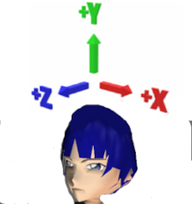
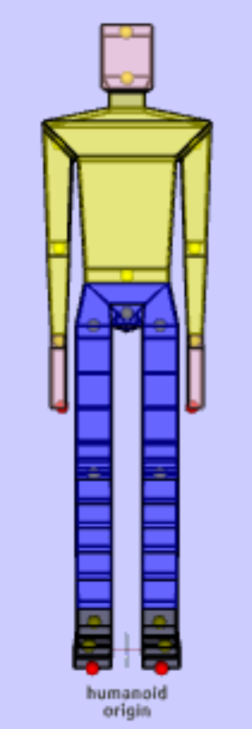
HAnim Coordinate System
HAnim humanoid models are defined using a right-handed coordinate system. Rotations follow the right-hand rule.
Given an origin centered between the feet on the ground plane and the relative perspective of the humanoid model:
+X axis direction is defined as the left side of the humanoid, while the -X axis direction is defined as the right side of the humanoid.
+Y axis direction is defined upward towards the top of model, while the -Y axis direction is downwards towards the bottom of the feet.
+Z axis is defined as the anterior direction towards the front of the model, while the -Z axis is defined as the posterior direction towards the back of the model.

Slide 7
Naming conventions for node DEF and name field
X3D 4.1
Strict name enumerations are uniquely defined for most joints and segments in the human body.
Alternative names can also be used but are not interoperable.
DEF labels are node identifiers that must have a consistent prefix (for example, hanim_ or Henry_) that match the prefix given in the name of the parent HAnimHumanoid.
This approach allows consistent run-time interoperability within a Humanoid model while also allowing multiple independent X3D models to coexist, interoperably and without mutual interference.

Slide 8
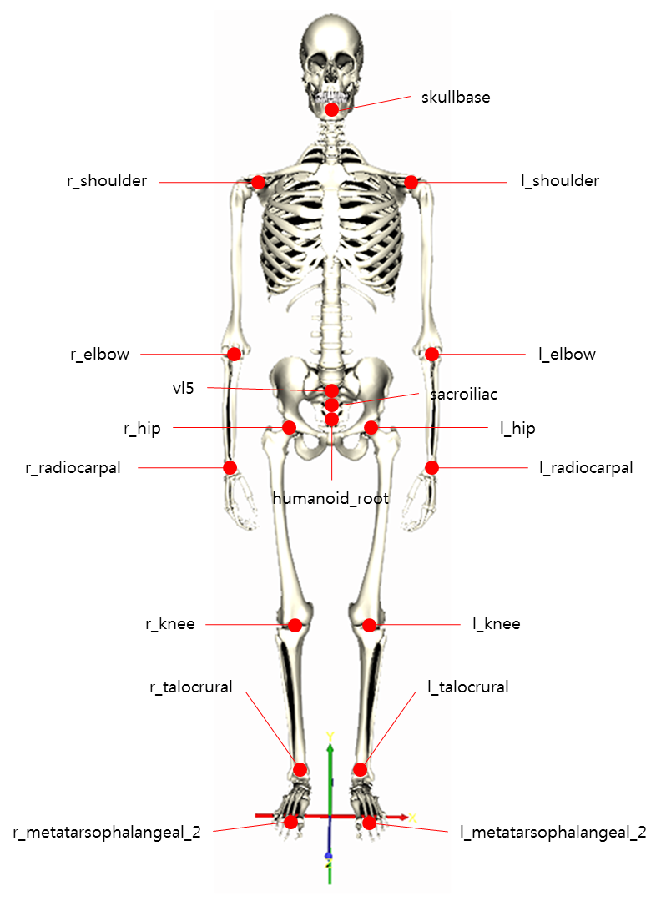
HAnim Levels of Articulation (LOA) 0..5
Animation interoperability is a key design goal of LOA representations, where animations for less-detailed LOAs can work correctly for humanoids at more-detailed LOAs. This enables composability of both model geometry and animation sequences.
The purpose of each LOA follows:
LOA-0. Humanoid location and direction,
LOA-1. Simple animation and poses,
LOA-2. Accepted baseline motion and sports,
LOA-3. Clothing and apparel plus individual's body posture,
LOA-4. Anatomically correct human skeleton with all movable joints.
LOA-5. Adds bone segments, cartilage connections, and teeth that are not ordinarily animated.
New in v2.1

Slide 9
Implementation Tools and Assets
X3D-Edit Authoring Tool
Sunrize Editor with X_ITE Browser and X_ITE Playground Editor
X3DOM Browser and X3DOM Editor
X3D Documentation stylesheet
X3D Quality Assurance (QA) tests
X3D Example Archives for Humanoid Animation
(what library did John use to scale into meters and then re-center each of bone meshes?)

Slide 10
Original availability of HAnim Bone models
Describe Damon’s original archive
Describe genesis of the models in different archives
Note that this derived work is open source with no restrictions

Slide 11
Inline, EXPORT and IMPORT
X3D 4.1
Inline node is essential for model re-use, composition and scalability
  Loads a model and embeds it in the current scene graph
  Support for X3D XML, ClassicVRML, JSON, and binary encodings
  Support for glTF 2.0 XML and encodings
EXPORT statement
  Allows an author to specify nodes in the model that can be directly accessed at run time for animation purposes (e.g. HAnimHumanoid)
IMPORT statement
  Allows next author to gain access to those EXPORTed nodes of Inline model
Mantis Issue 1530 shows simplified mechanisms for humanoids to avoid duplicative statements beyond top-level HAnimHumanoid

Slide 12
InlineGeometry retrieves mesh geometry
X3D 4.1
InlineGeometry is a newly proposed and implemented node
  Retrieves geometry only, typically providing a mesh of polygons
  Initially designed to support STL and PLY formats for 3D printing,
  Also usable with X3D, VRML, and possibly other file formats
Benefits
  Allows application of independent Appearance and Material nodes
  Avoids retrieving any other unrelated (or unwanted) X3D nodes in the remote model that Inline IMPORT might return
InlineGeometry allows authors to create a custom HAnimHumanoid that only re-uses HAnimSegment geometry of interest
  EXPORT and IMPORT do not pertain

Slide 13
Production workflow for Bones in X3D
Copy, create empty skeleton using template
Apply name prefixes within the HAnimHumanoid
Retrieve correct geometry at each point within Joint, Segment tree
  Use Inline for prepositioned models
  Use InlineGeometry for zero-centered meshes, then apply Transform offsets and Appearance/Material throughout
Adjust HAnimJoint center fields to match centers of rotation
Test visually at each step for correct placement, animation
X3D-Edit: frequently test XML validation, Quality Assurance (QA)

Slide 14
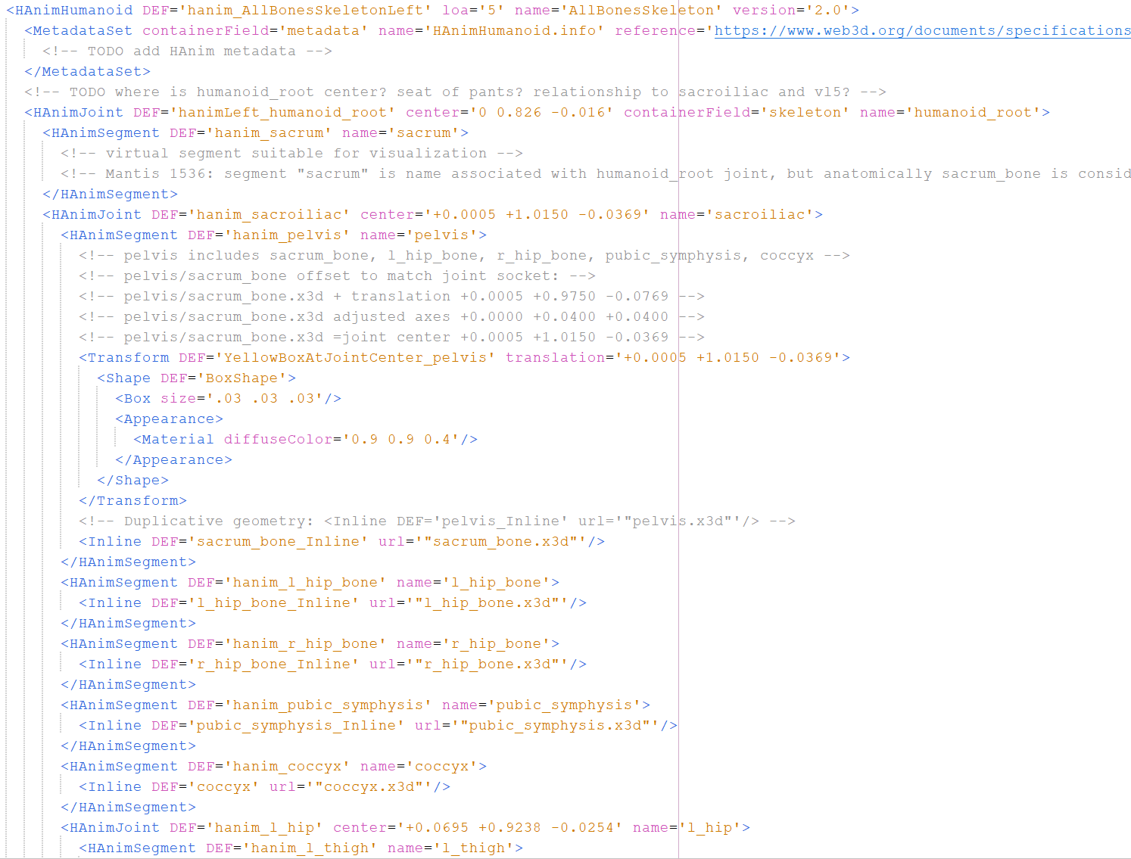
Design pattern
HAnimJoint and HAnimSegment

Slide 15
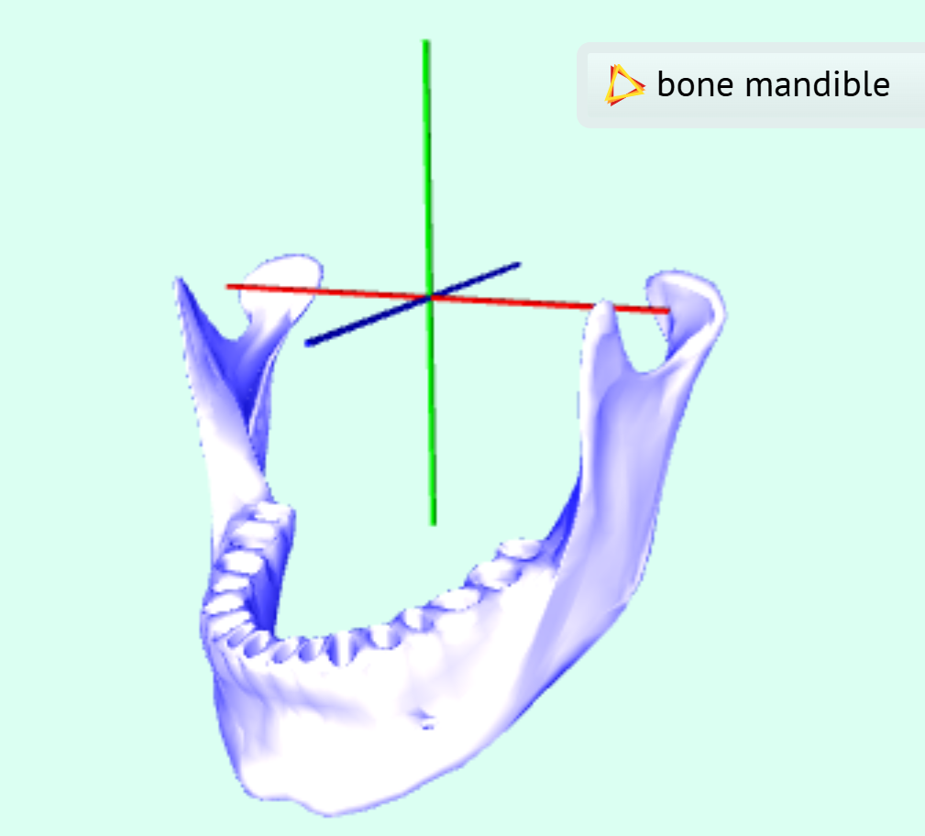
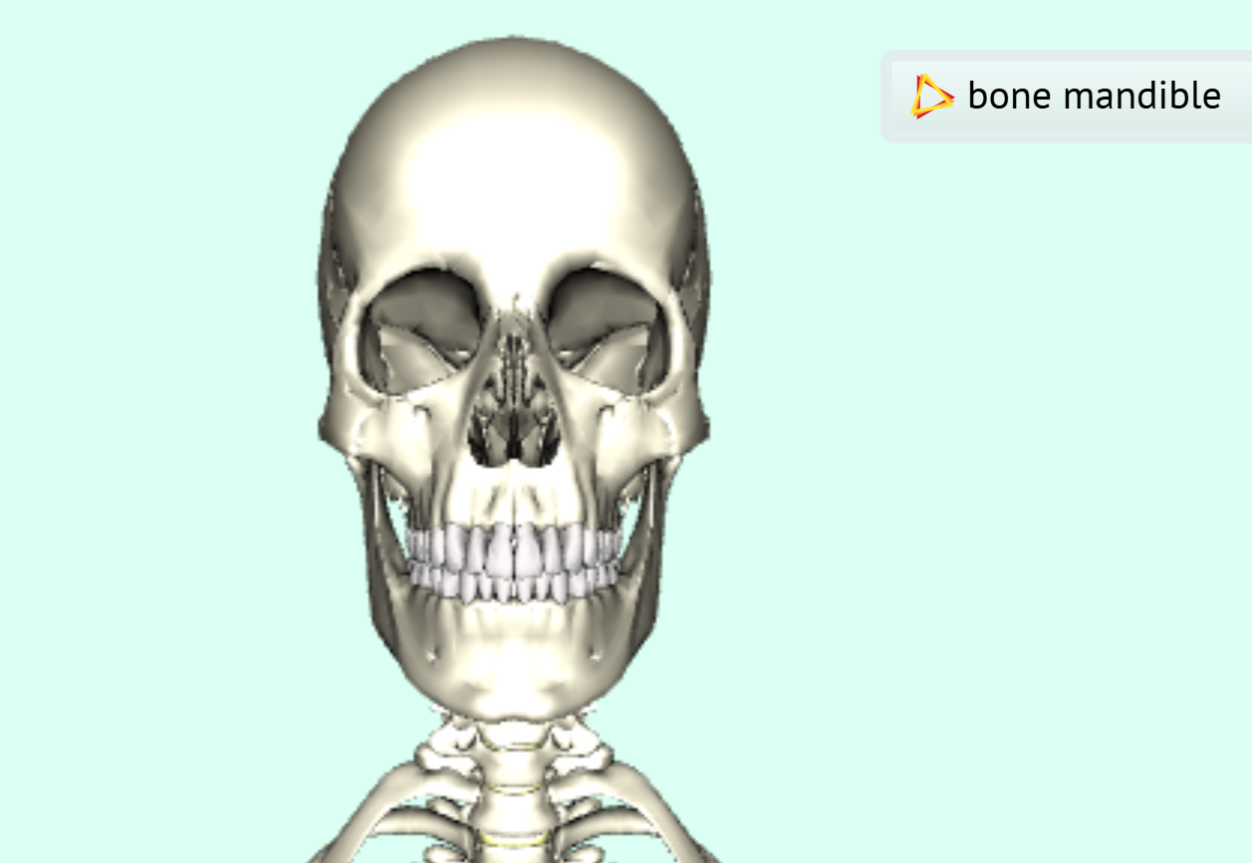
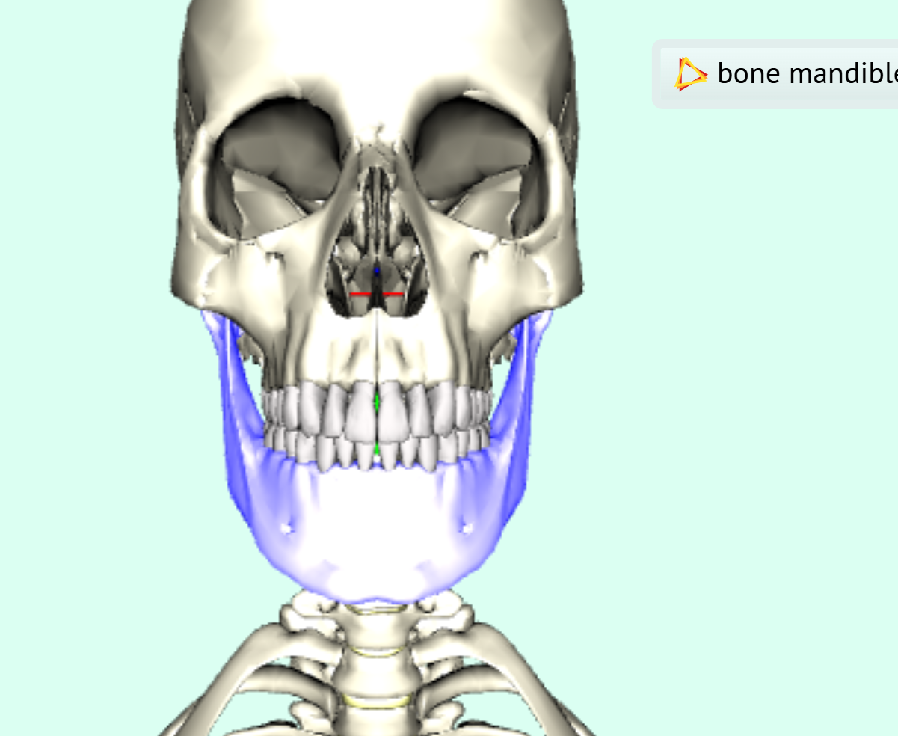
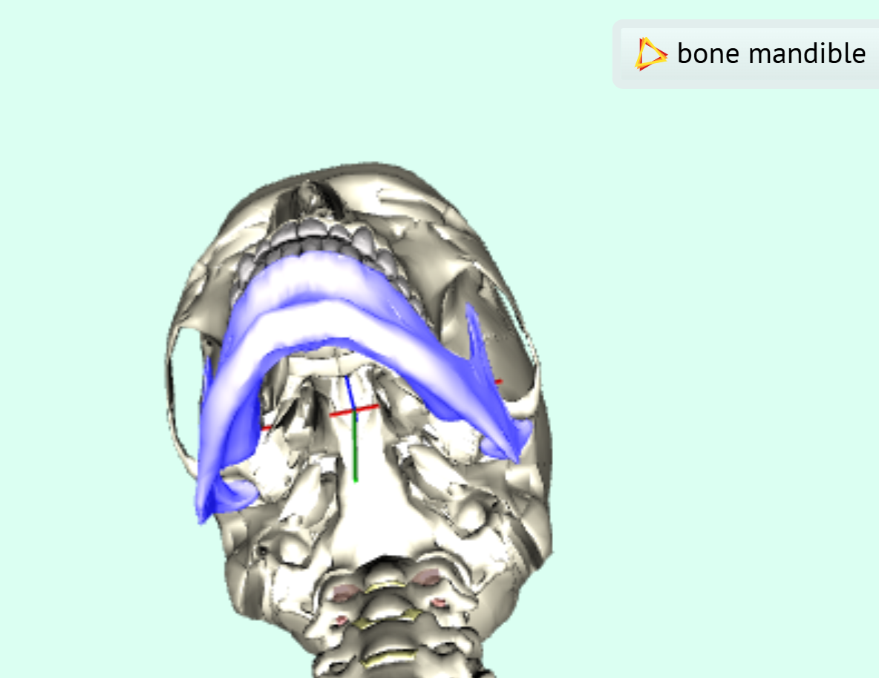
Visualizing joint centers of rotation
Difficult to coordinate both location and center of rotation of joints
Difficult to keep track of hundreds of named joints and segments
  Precise HAnim X3D naming conventions for DEF, name fields essential
  Multiple approaches considered, simplicity considered best
Each individual bone model has TouchSensor as user’s trigger for
  Hover: displaying name of segment geometry to aid exploration
  Select: provide highlight lighting, close-in view, display X-Y-Z axis if present
  No custom scripts, all native X3D. Essential for visual debugging of model

Slide 16
Visualizing erroneous joint centers of rotation
Misplaced sacrum example
What some other errors looked like…
Take-away points:
Tools and processing workflows can follow these patterns too
Once again, visual debugging is essential for success

Slide 17
Resizing an HAnim skeleton
Original JinLOA4.x3d
Served as template for Bones model
After replacing individual bones, adjusting joint center of rotations necessary so that skeleton with bone segments of different lengths can re-use the same animations

Slide 18
Using Inline to load segment models with absolute location
Show example

Slide 19
Using InlineGeometry to load segment meshes with absolute location
Show example

Slide 20
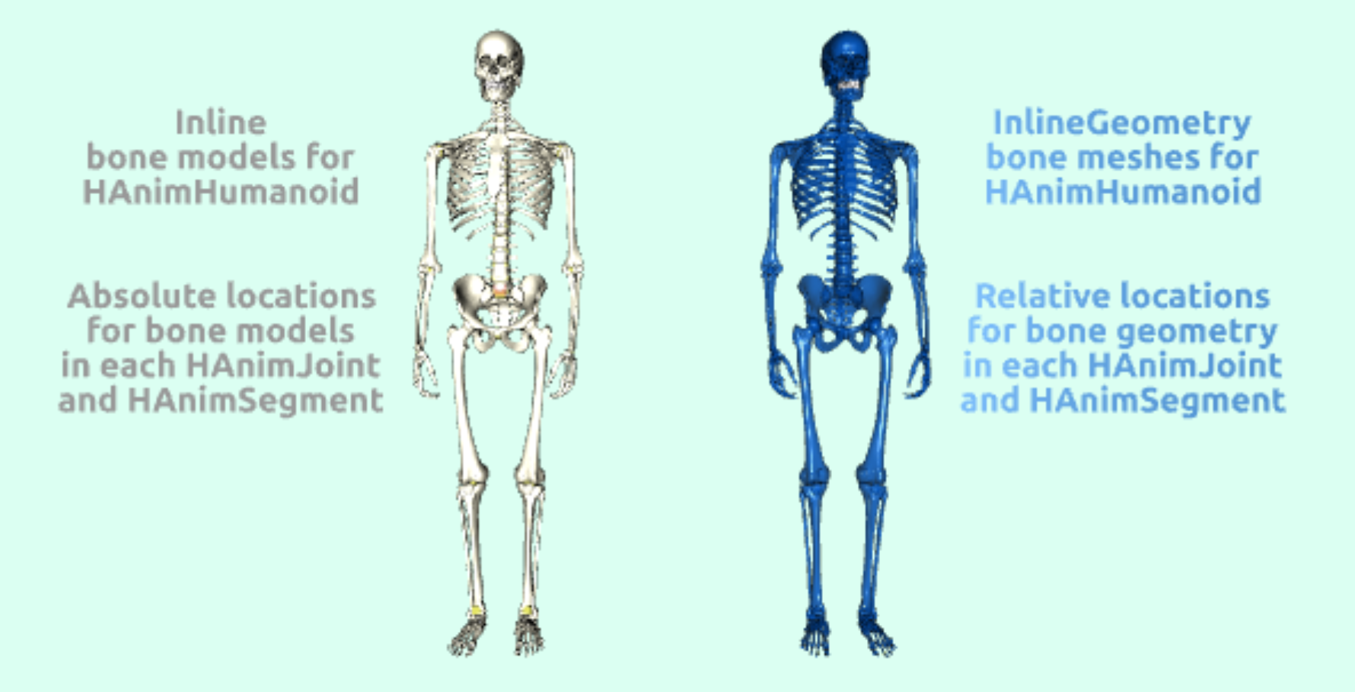
Example HAnim/X3D for absolute Inline models and relative InlineGeometry meshes
X3D Example Archives: Humanoid Animation, Bones,
All Bones LOA 5 Skeletons
Both cases apply the exact same HAnimHumanoid, HAnimJoint, HAnimSegment structures

Slide 21
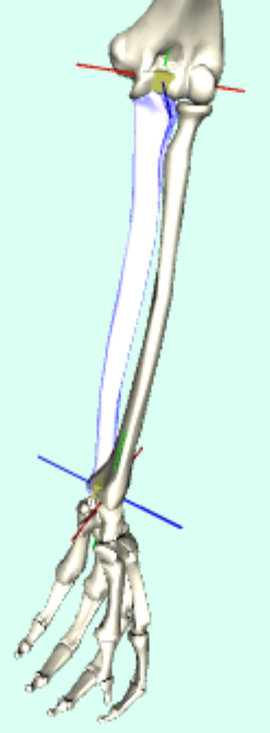
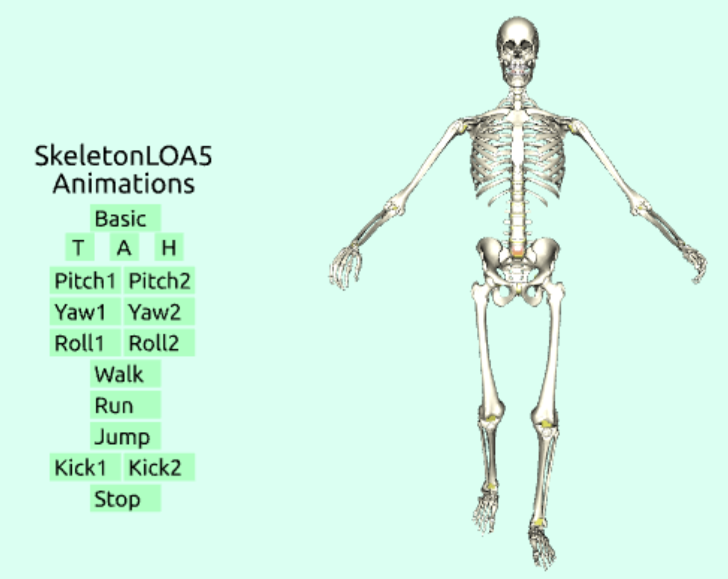
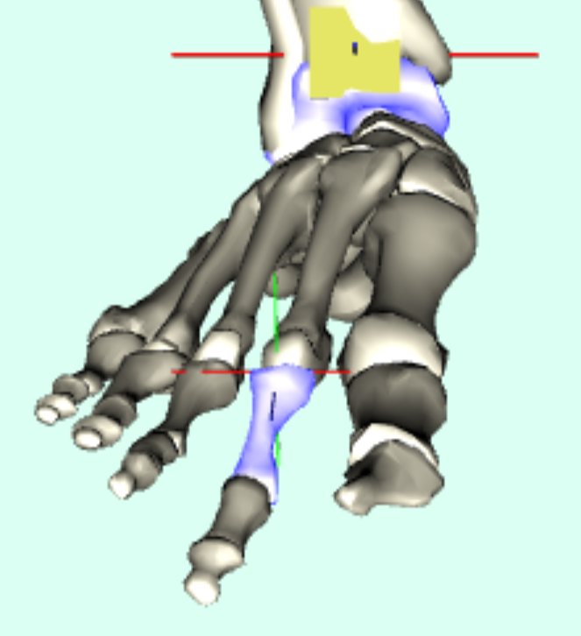
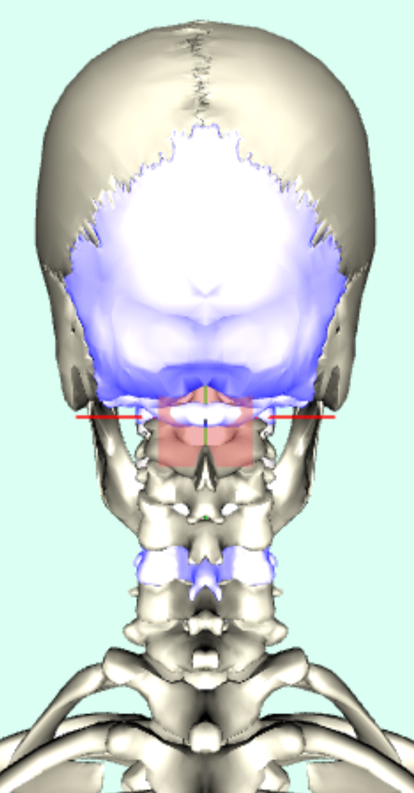
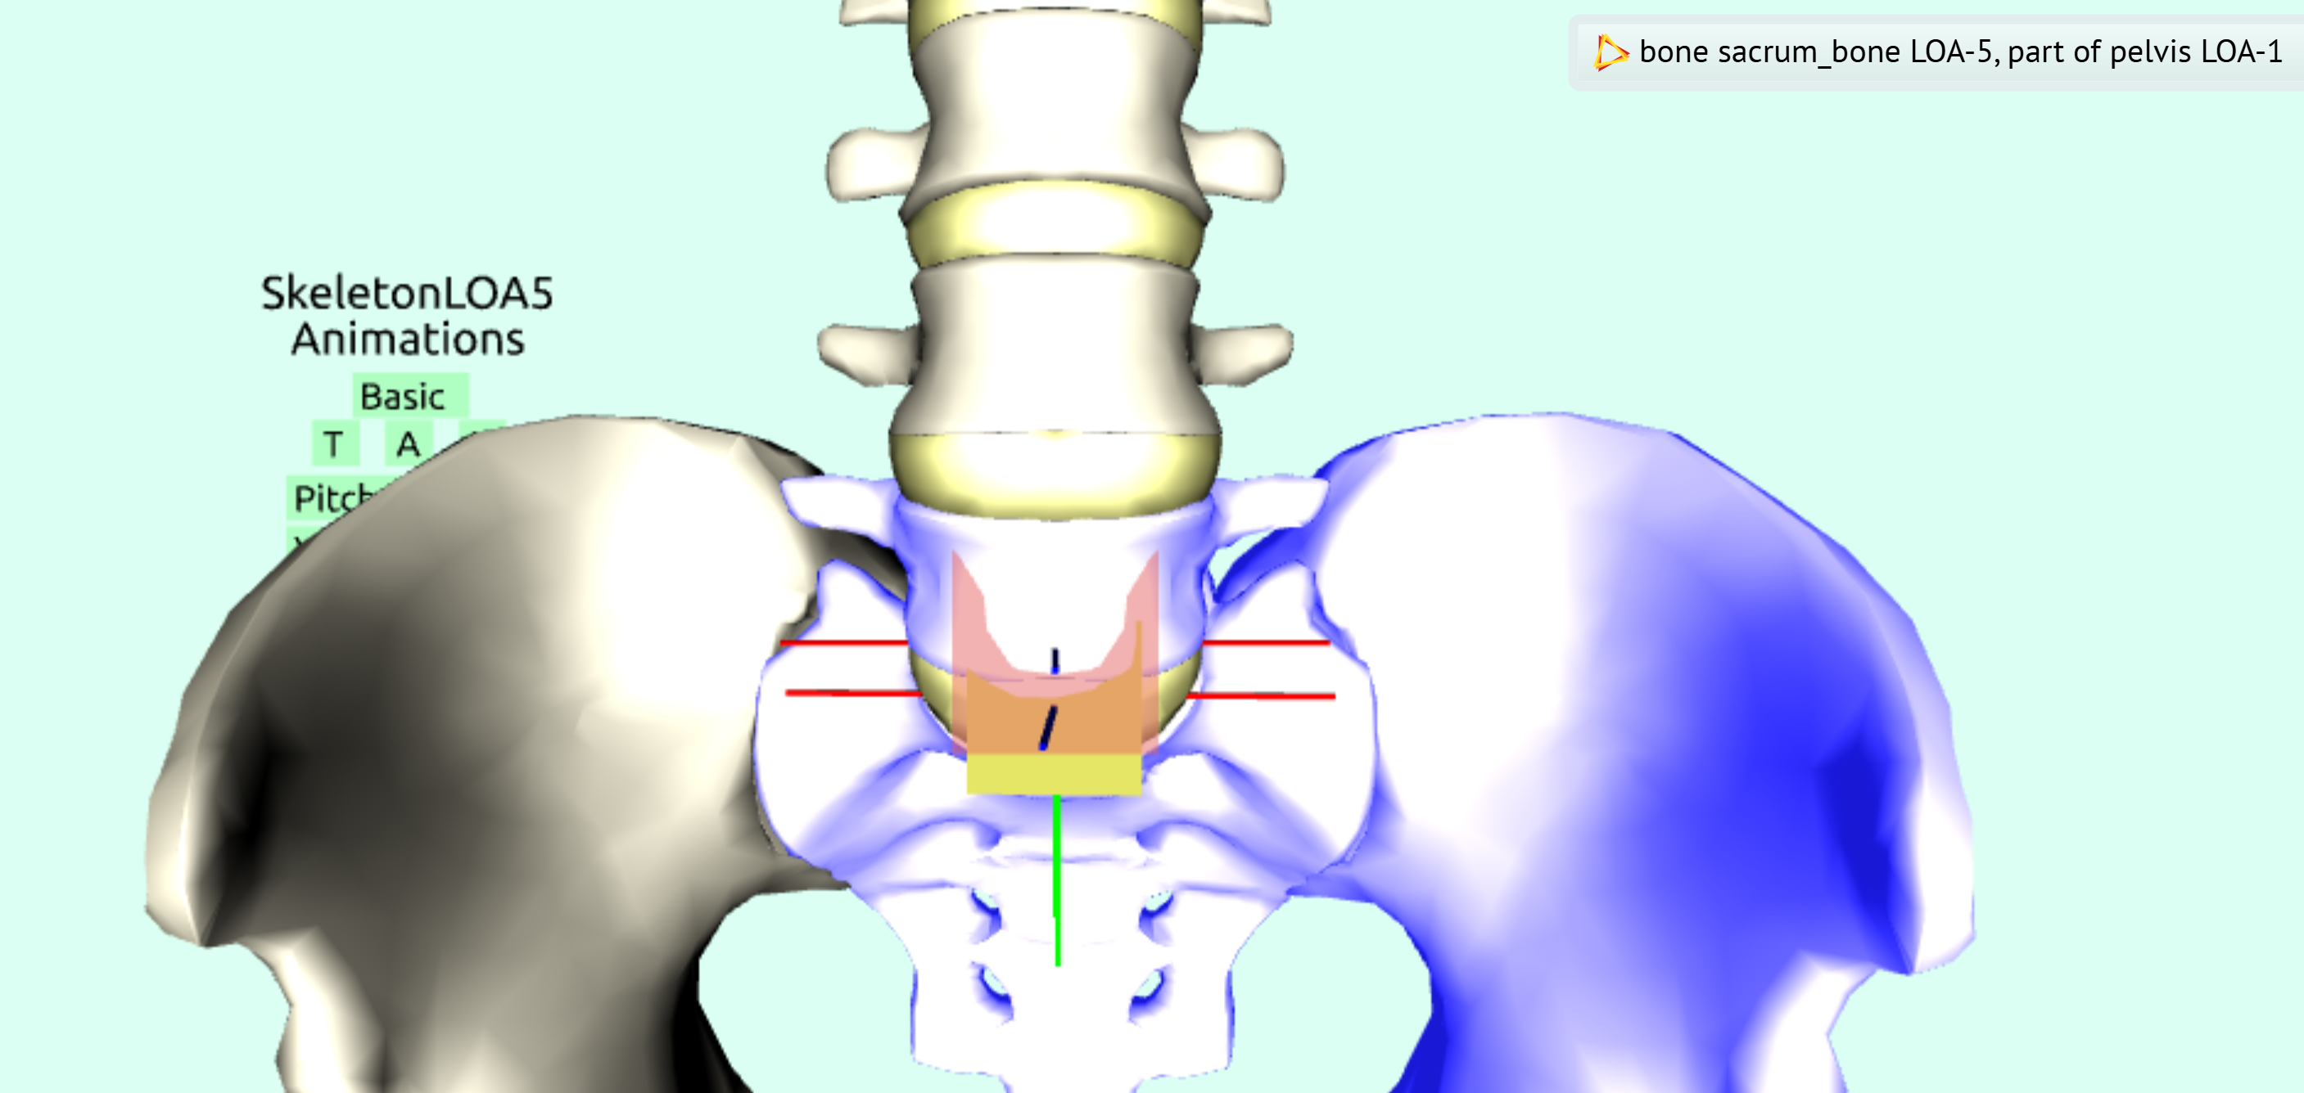
Test scene to visualize Joint centers
X3D Example Archives: Humanoid Animation, Bones,
All Bones LOA 5 Skeletons Inline Animation

Slide 22
Animation examples
Switchable Interpolators
Green-box pitch/roll/yaw examples
TODO: HAnimPose examples (BoxMan, at least)
TODO: HAnimMotion example derived from BVH data

Slide 23
References
To describe work used on the path taken,
Order of development:
* https://www.web3d.org/x3d/content/examples/HumanoidAnimation/Medical/SkeletonCompleteNoNormalsIndex.html
* https://www.web3d.org/x3d/content/examples/HumanoidAnimation/Medical/AnimatedAssembledHumanSkeletonIndex.html
Running skeleton (not yet submitted to archive)
* https://www.web3d.org/x3d/content/examples/HumanoidAnimation/Medical/LaughingUpperSkeletonIndex.html
To support the paper for Web3D 2026,
To encourage even-better work by others in the future!

Slide 24
Conclusions
Yes we can do it…
This presentation is outline of paper for Web3D 2026 Conference

Slide 25
Recommendations
Improved conversion tools to facilitate model construction
Quality Assurance (QA) tools for model conversion, correctness
Continued specification formalization
Continued implementation, evaluation, refinement, deployment
Define correspondences with other common approaches shared as part of Metaverse Standards Forum (MSF) efforts
Consider integration with medical standards as 3D health records

Slide 26
Acknowledgements
HAnim Working Group participants
Browser builders: X_ITE, Castle Model Viewer, X3DOM
John Carlson for recentering bone model meshes using ___ library
IEEE Body Processing Working Group

