Slide 1
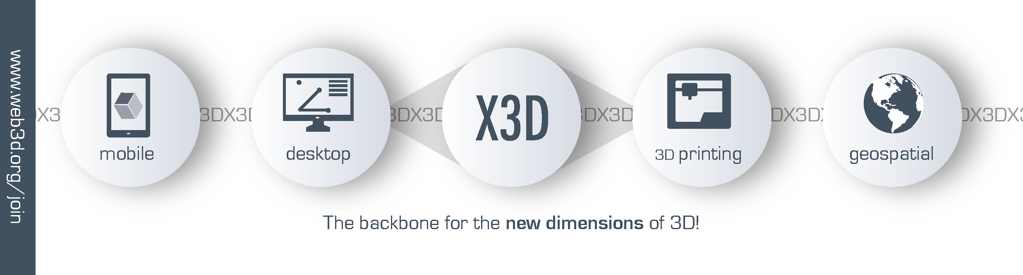
Web3D and X3D Overview
WWW.Web3D.ORG
X3D: Your Hub for Interactive 3D Applications
Anita Havele, Executive Director , Web3D Consortium
Email: anita.havele@web3d.org
Notes:
Introduction

Slide 2


About Web3D Consortium
International, non-profit, member funded, standards development organization
Developing royalty free ISO specifications for 3D
Our standards: X3D and HANIM
Community of technologists, enterprise and artists
Members: Academia, Industry, Government and Professionals
www.web3d.org/about

Slide 3
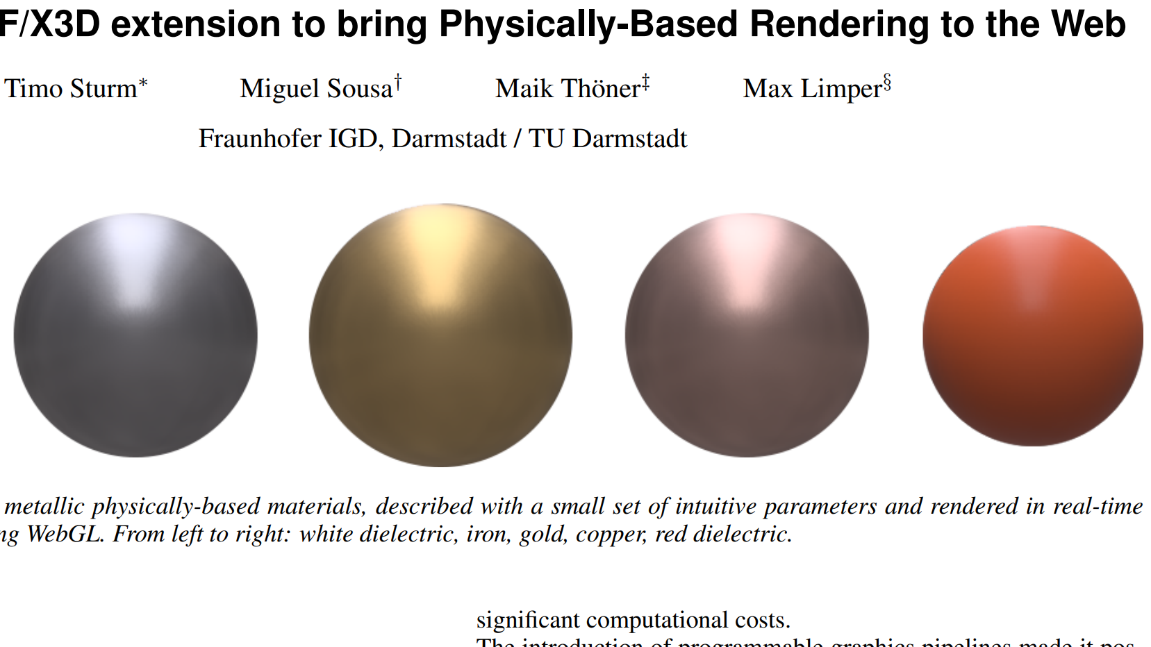













Our Journey
Binary Streaming
AR - 3D - VR
In Browser Rendering
VR devices
2016
2019
2020
Declarative 3D on the Web
2015
2014
2013
Interchange
Tool chain support
2007
XML – Programmable
V 2.0
V 4.0
Draft
2005
X_ITE
Animation, Scripting
Interactivity
V 3.3
Model + hyperlink
1997
V 1.0
V 3.0
Annual Web3D Conferences
2020 - 25th Year
1994
V 2.0
V 1.0
Evolution Collaboration Standardization Democratization 3D Printing HTML5 VR/AR

Slide 4
Web3D Consortium Goals
Universities
& Research
Evolve open Web3D based 3D technologies
Empower 3D/VR Developers
Guide Policy Makers
Encourage enterprises and industry to use open X3D standards
Members
Web3D
Consortium
Government
Industry
Community

Slide 5
Active ISO Web3D Standards
X3D Version 3.3
HAnim Version 2.0
Humanoid Animation
File Format and Rendering Engine
X3D standards and HANIM Ratified by
ISO/IEC JTC 1/SC 24 WG 6
www.web3d.org/standards

Slide 6

Web is our platform
3D + VR + AR Capable
DOM Integrated
  Change scene content through DOM
  Render with WebGL
  Inline glTF
Interaction
Animation
www.web3d.org/x3d/why-use-x3d

Slide 7

X3D: Real-time interactive 3D
Delivery of virtual environments over the web
A language to add 3D models, geospatial and Imagery into a 3D application
Multiple encodings: XML (.x3d), Classic VRML (.x3dv), Compressed Binary (.x3db), JSON
Multiple APIs: JavaScript, Java, C#, C++, C, Python
HTML5, CSS, JavaScript Compatible
Profile and Component structure to promote interoperability
Multiple open source implementation: X3DOM and X_ITE
X_ITE
www.web3d.org/x3d/what-x3d

Slide 8
Interactive 3D Web applications is our sweet spot
Publishing 3D with interactivity
A language to add 3D models, geospatial and imagery into one system (3D application)
JS API X3D browsers: X3DOM and X_ITE use WebGL for native rendering. NO plugins required!
Standalone X3D browsers: Instant Reality, BS Contact
X_ITE
www.web3d.org/x3d/why-use-x3d

Slide 9


Comparing 3D Technologies
X3D – Declarative 3D for web programmers
Declare a box
* X3DOM or X_ITE (WebGL supported browsers)
* Instant Reality (Stand alone browser)
WebGL – Imperative 3D for graphics programmers
        Define a box
        * Render in WebGL
glTF – 3D geometry + materials rendering(PBR)
An efficient transportable 3D assets
You need X3D to compose several 3D asset into a meaningful 3D Web applications
`
www.web3d.org /x3d/why-use-x3d

Slide 10







Web3D Standards Global Adoption
Web3D Standardization Process
Volunteers and Members work together on Standards
Web3D Working Groups:
X3D
Medical
Geospatial
Mixed Reality
Heritage
Semantics
Design Printing & Scanning
Web 3D UX
SDO Partnerships:
www.web3d.org/about/liaisons

Slide 11
Bringing open Web3D Standards to ALL
Web3D
Standards
Web3D
Consortium
Working Groups
Recommendations
OPEN
ROYALTY FREE
ISO RATIFIIED
WEB3D STANDARDS
Standards Bodies
ISO, W3C OGC, DICOM, IEEE, HL7, KHRONOS
Standardization
Adoption
GOVERNMENT
COMMUNITY
MEMBERS
INDUSTRY

Slide 12






Who is using X3D?

Slide 13
Our Journey
Binary Streaming
AR - 3D - VR
In Browser Rendering
VR devices
2016
2019
2020
Declarative 3D on the Web
2015
2014
2013
Interchange
Tool chain support
2007
XML – Programmable
V 2.0
V 4.0
Draft
2005
X_ITE
Animation, Scripting
Interactivity
V 3.3
Model + hyperlink
1997
V 1.0
V 3.0
Annual Web3D Conferences
2020 - 25th Year
1994
V 2.0
V 1.0
Evolution Collaboration Standardization Democratization 3D Printing HTML5 VR/AR

Slide 14
Web3D: 2019-2020 Highlights
    Covid-19 Spotlight:
    Our members NIH and NPS are providing helpful 3D Printing
    X3D resources in this crisis.
    Standard:
    X3D Version 4.0 - Released public draft
    HANIM 2.0 Released
SDO
  HL7 – Keynote Speaker
  IEEE 3D Body Processing – 3D Body Tech Conference Key Presenters
Events:
    SIGGRAPH 2019
    Web3D 2019
    Collaborative 3D Visualization Workshop with DOD
www.web3d.org/news-events

Slide 15
X3D is Evolving - X3D version 4.0
Always backward compatible
Highlights
HTML5 Integration
X3D Unified Object Model (X3DUOM)
3D printing of models
3D scanning of objects, and support for point clouds
Model structure with complete metadata.
Volume visualization
Annotation
Inlining glTF assets
Physical Based Rendering (PBR)
Archival publishing of cultural and natural heritage
X_ITE
Open-source implementations, X3DOM and X_ITE
www.web3d.org/x3dv4-highlights

Slide 16
X3D is Evolving - X3Dv4
Always backward compatible
Timeline - Draft 2020 - ISO Ratification
X3Dv4 is available in all browsers
https://github.com/Web3dConsortium
Released public draft
Authors have the archival stability of a well-tested long-lasting specification to build upon
www.web3d.org/x3dv4-highlights

Slide 17

New SDO Collaboration
Extensions that are relevant to IEEE 3D Body Processing
open standard enabling visualization and metadata exchange for 3d body model
Developing examples using X3D to visualize healthcare data.
Demographics and distribution of illness in a hospitable system
Test results of CPET exercises tests, X3D enables interactive 3D charting.
www.web3d.org/about/liaisons

Slide 18
X3D: Working Groups Highlights
The X3D Working Group: Is shipping the second public working draft (WD2) of the X3D Version 4 specification (X3D4).
Design, Printing and Scanning (DPS): Developing standards and practices for robust and secure visualization of STEP Product Data, with valuable collaboration with other visualization formats such as JT and 3D-PDF.
Geospatial: Workflows and systems to support glTF and a Cesium Tiles-type approach for dealing with large and complex scenes.
Medical Working Group: Through our HL7 Liaison relationships, the Medical WG has developed several examples using X3D to visualize healthcare data.
Heritage: Creating a Web3D library from their world-class insect collection.
Interested Members should join us!
WWW.Web3D.org/X3D/working-groups

Slide 19
X3D: New Working Groups
Semantic Web: Web interoperability and enable intelligent 3D applications, feature-based 3D model querying, and reasoning over 3D scenes.
Web 3D User Experience: Supporting rich user experiences (UX), intuitive navigation, and effective interaction techniques for a variety of 3D Web technologies.
Now is the time to join Web3D!
www.web3d.org/working-groups

Slide 20
Web3D Resources
Membership: www.web3d.org/join
Web3D Standards: www.web3d.org/standards
Work Groups: www.web3d.org/working-groups
Case Studies: www.web3d.org/case-studies
Workshop: www.web3d.org/Web3d-quickstart
Examples: www.web3d.org/x3d/content/examples/Basic
News & Events: www.web3d.org/news-events

Slide 21



Upcoming Events
Web3D Webinars 3-6 August 2020
Learn X3D, X3D Browsers, X3D Tools
www.web3d.org/webinars
Web3D Virtual booth at SIGGRAPH 2020 Starting August 17, 2020
https://s2020.siggraph.org/conference/
FREE Virtual Web3D 2020 Conference 9-13 November 2020
www.2020.web3dconference.org
www.web3d.org/news-events

Slide 22
Web3D Consortium Member Benefits
www.web3d.org/join
Marketing
Promote
products
Conference participation
Booth
partnership
Business
Opportunities
Business
partnership
Joint grants
Web3D Talent Bank
Access to Web3D experts
Drive Web3D
Standards
Working Group participation
Early access
to spec
Board Seat
Networking
Industry Leaders
Research experts
3D companies
Government
Industry
www.web3d.org/member-benefits
Join Web3D Consortium as we build open interactive 3D standards

Slide 23

We are going to simulate our 3D worlds one way or the other
How important is it to build a framework for open interoperable 3D technologies?

Slide 24
Join Web3D and Participate
www.web3d.org
Would you like to join in?
  Participants always welcome
    http://www.web3d.org/join
What are we overlooking?
  suggestions are always welcome
    x3d-public@web3d.org
Contact
Anita Havele
Executive Director,
Web3D Consortium
Anita.Havele@Web3D.org
www.web3d.org/join

